Slide 1
AUTISM AWARENESS MONTH

Slide 2
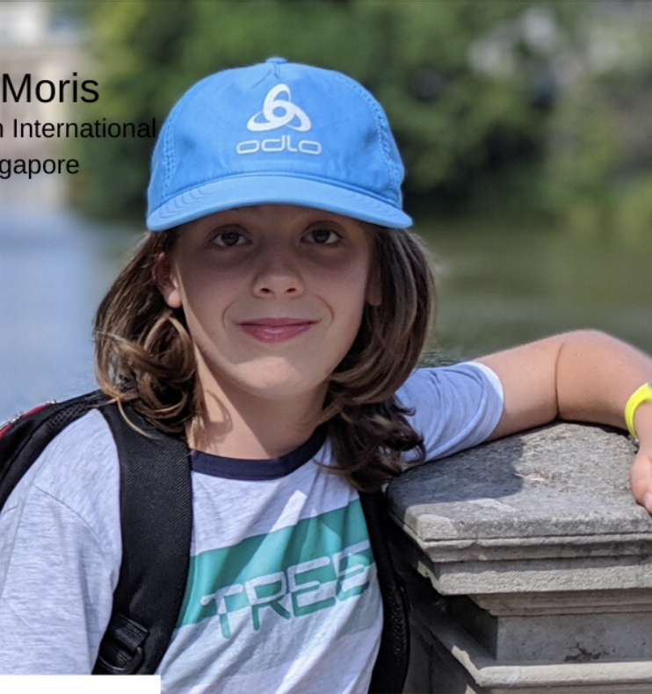
What is World Autism Awareness Month?
World Autism Awareness Month recognizes and spreads awareness for the rights of people with autism
It also aims to put a spotlight on the hurdles that people with autism and others living with autism face every day.
Raphael Moris (2020 SENIA Student Award)
Stamford American School Singapore
Learn more about his advocacy here

Slide 3
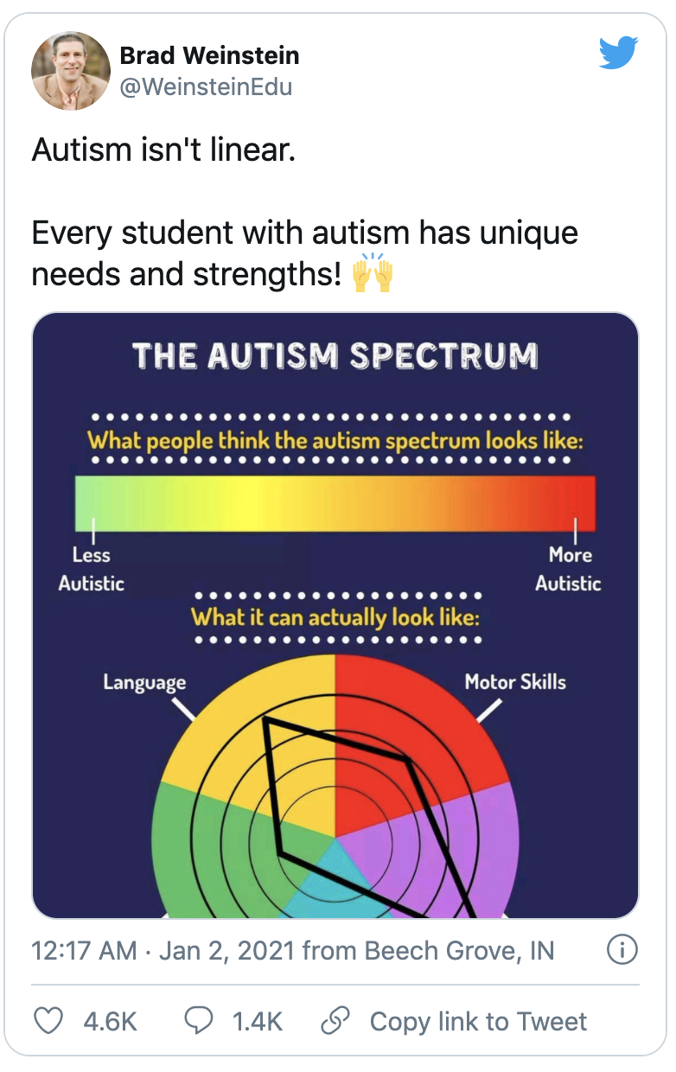
How to observe World Autism Awareness Day?
Share information online
Even nowadays when almost everyone has access to information, there are still many people that don't know about autism and the characteristics of people with it. Become an advocate for the autistic community by educating the masses. Retweet, share a podcast or a video. Let’s all learn together!

Slide 4
How to observe World Autism Awareness Day?
Get involved with autism associations
There are many people who either have autism or have a family member with autism and are a part of community-wide, nationwide, or global-wide association. Get in contact with them to get involved in any activities planned for the day.

Slide 5
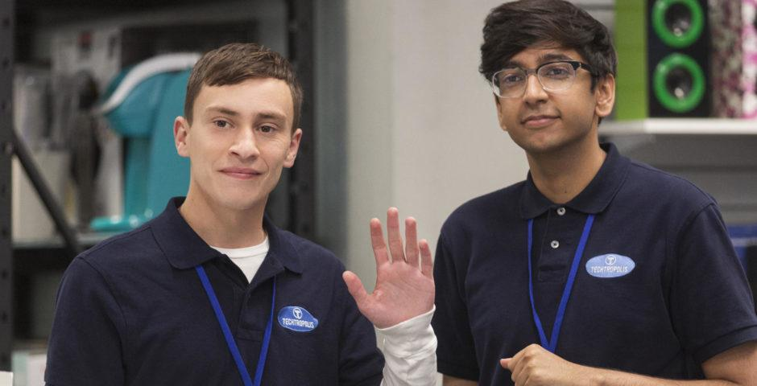
How to Observe World Autism Awareness Day?
Be a friend to someone on the spectrum
World Autism Awareness Day is the perfect day to have a good time with your friends who are diagnosed with autism! Make sure to plan sensory-sensitive activities for you both to enjoy and be sure to find out if they are on a special diet.

Slide 6
Learn More about Autism through reading

Slide 7
Learn More about Autism through TV shows and films

Slide 8
What are some strategies when engaging with a friend or classmate that has autism?
Audience: ES
Place your screenshot here

Slide 9
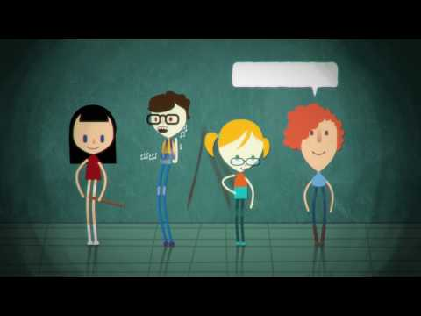
Autism in a nutshell.
Audience: MS/HS
Place your screenshot here

Slide 10
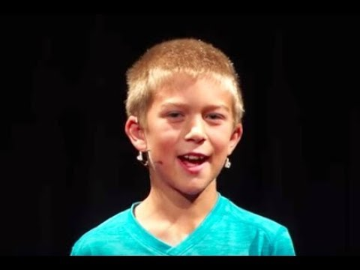
We are all different and that’s awesome!
Audience: MS/HS
Place your screenshot here

Slide 11
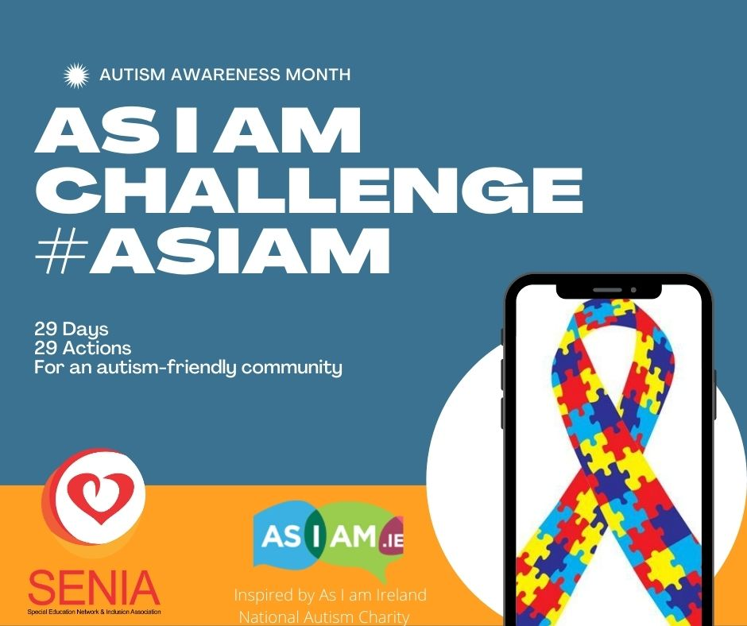

Slide 12
How does it work?
Every day the autism community adapts to a world which is often not designed to meet its needs. Small changes in how people think and act can be the difference between the autism community being able to participate or not. We want to show wider society what these changes are and how they can be implemented.
Starting on April 1, we will share one simple action per day which you can undertake in order to be more autism-friendly. We will begin with simple behaviours right through to significant measures which can be put in place to make an impactful change.
Inspired by As I am Ireland

Slide 13
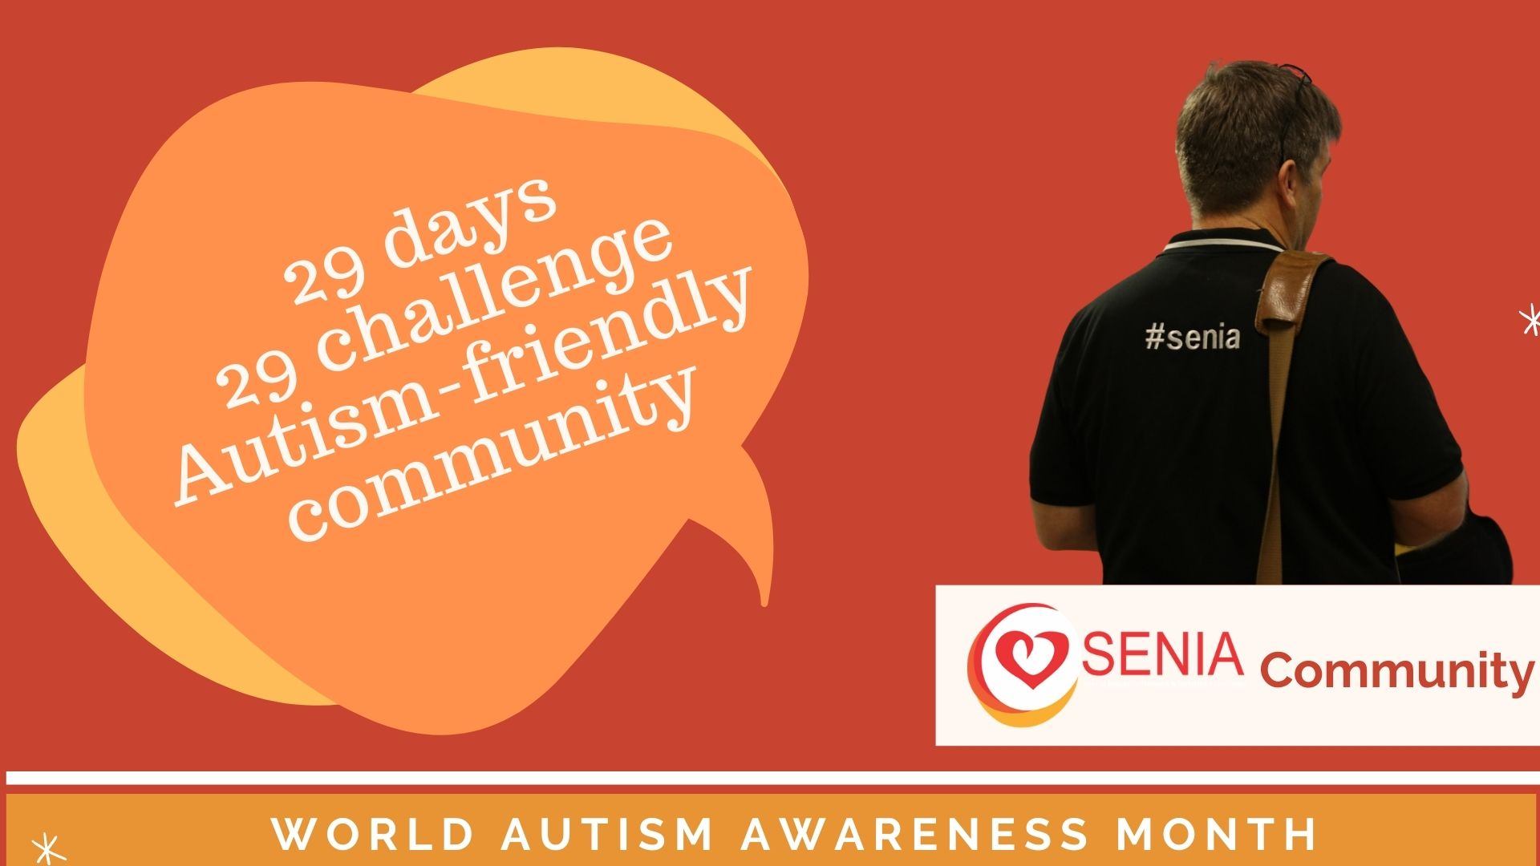
How does it work?
#SENIAcommunity extends an open invitation for you to take on our 29 Day Challenge, we want to see your posts, comments, pics and videos. Whether you join us on day one, five or for the whole 29, we want to see you getting involved!

Slide 14
Join the challenge!
Each day we will share the Challenge on our website and social media platforms along with supporting material such as tools, videos or blogs on why they are important
Facebook - SENIA International
Twitter - seniaworldwide
Instagram - seniainternational
Use the hashtags #AsIam #SENIACommunity to show your support.
Notes:
›

Slide 15
